Slide 1
Phase-5
Go-Back-to-N RDT Protocol

Slide 2
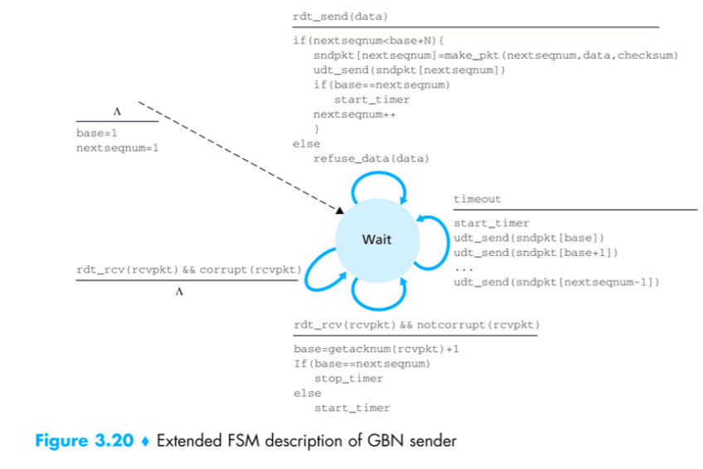

Slide 3
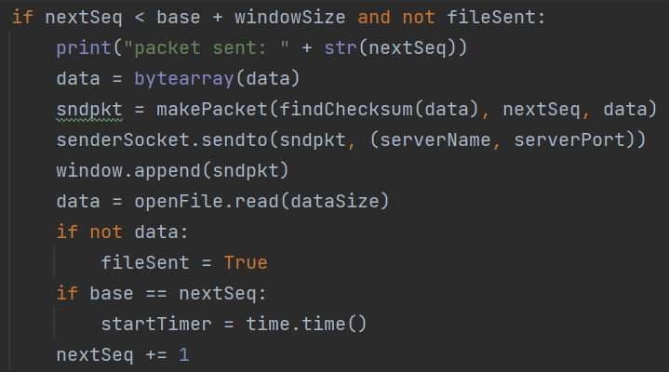
FSM @sender: rdt_send(data)

Slide 4
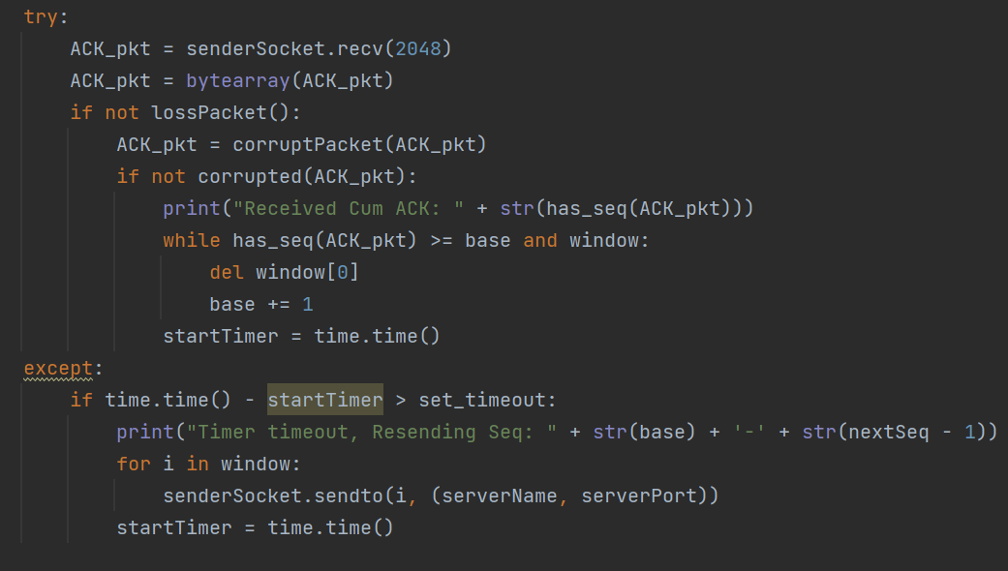
FSM @sender: Cumulative ACK and Timeout

Slide 5
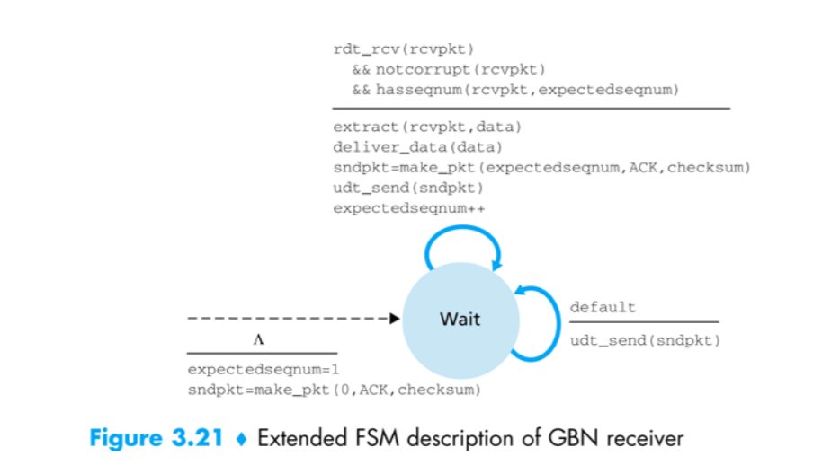

Slide 6
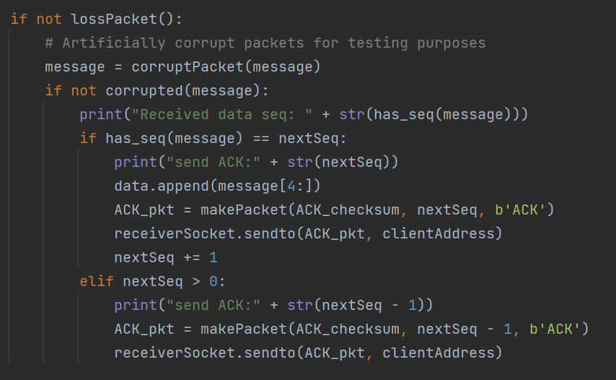
FSM @receiver: ACK send and default states

Slide 7
Parameters used for generating the results.
Image file : 5 Mb .jpg
dataSize = 1024
base = 0
nextSeq = 0
windowSize = 5
set_timeout = 0.01

Slide 8
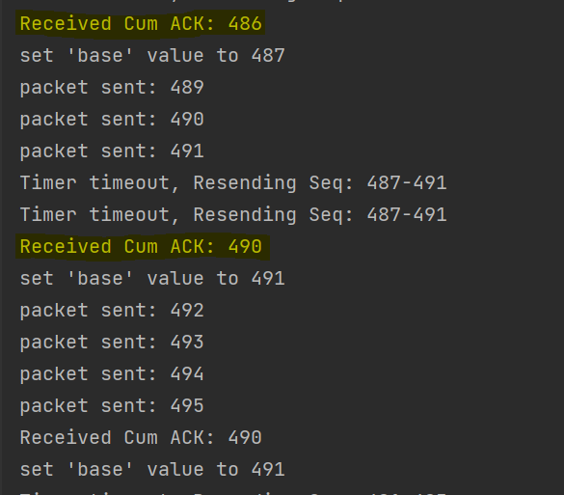
Cumulative ACK at Sender
Received ACK at Sender side
In the right figure, the last ACK was 486 and there was no ACK received until ACK packet 490.
After receiving ACK 490, the ‘base’ value of the sender will be set to 491, though there was no ACK in-between.
This case confirm the implementation of Cumulative ACK.

Slide 9
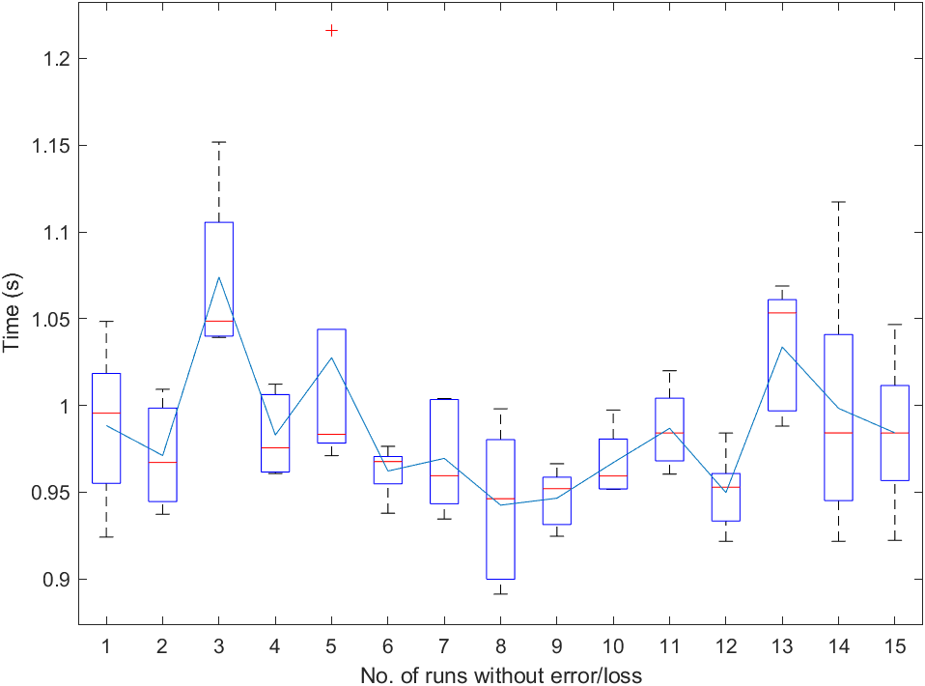
Chart 1: Phase 5 performance
The figure contains- Average time plot and range of time as boxplot (+ are outliers).
Multiple data are obtained at every run and the boxplot is generated.
Each boxplot contains minimum, 25%, median, 75%, and maximum information of data.

Slide 10
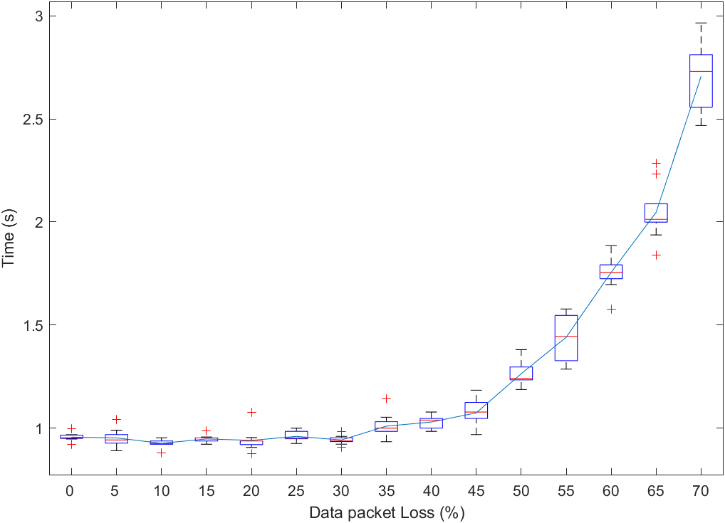
Chart 1: Phase 5 performance
The figure contains-
Average time plot.
Range of time at a fixed loss as boxplot (+ are outliers).

Slide 11
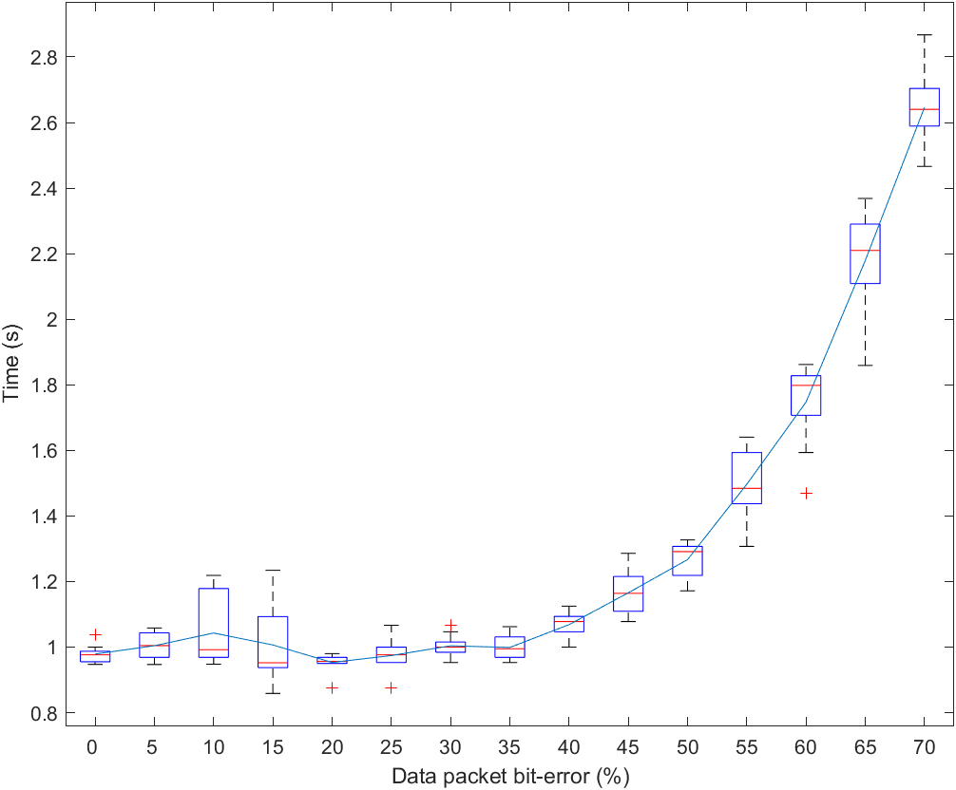
Chart 1: Phase 5 performance
The figure contains-
Average time plot.
Range of time at a fixed loss as boxplot (+ are outliers).

Slide 12
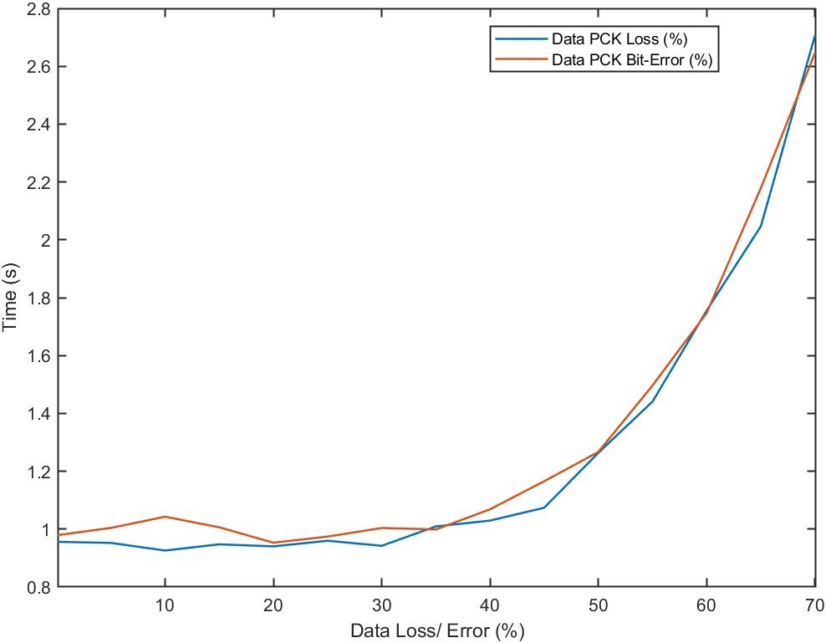
Chart 1: Phase 5 performance
The figure contains-
Average time plot for Data packet loss and bit-error (%)

Slide 13
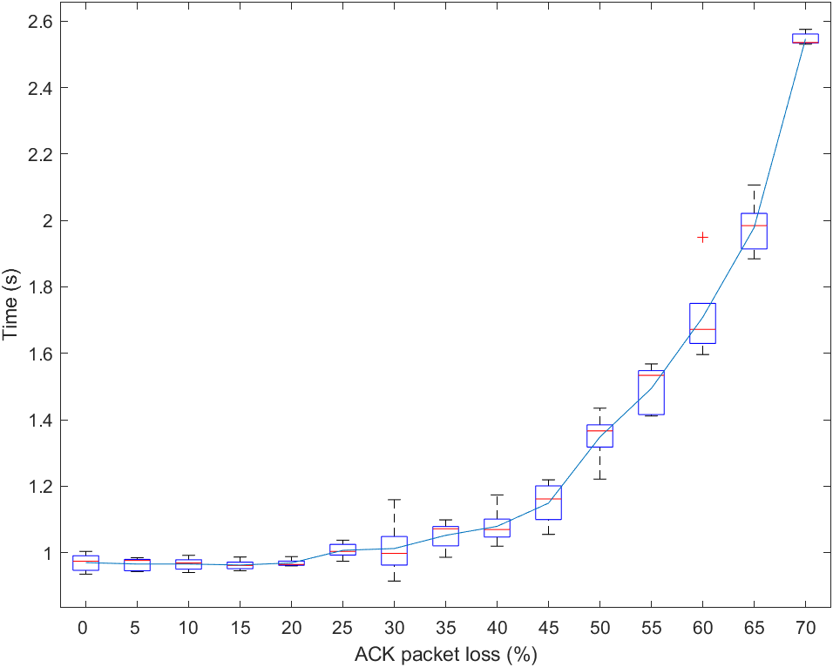
Chart 1: Phase 5 performance
The figure contains-
Average time plot.
Range of time at a fixed loss as boxplot (+ are outliers).

Slide 14
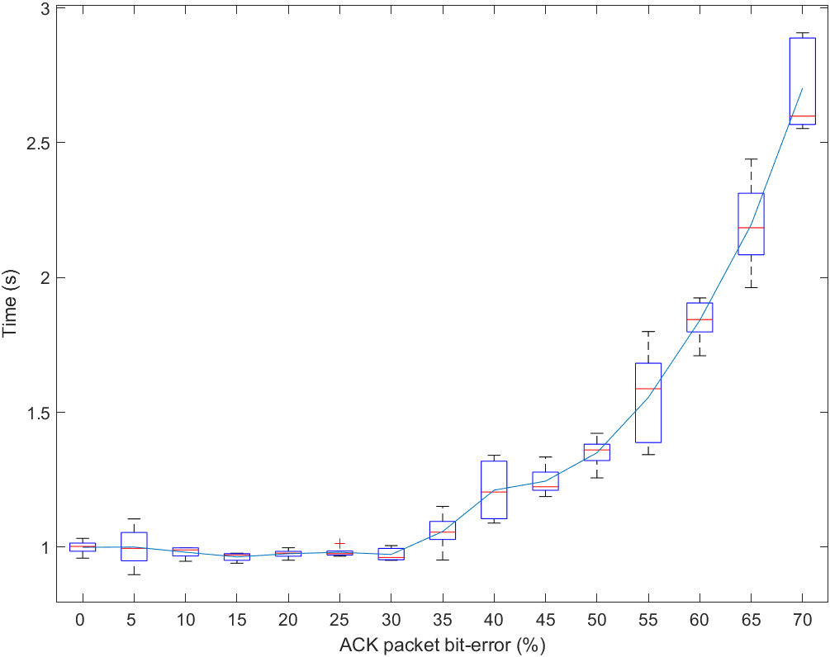
Chart 1: Phase 5 performance
The figure contains-
Average time plot.
Range of time at a fixed loss as boxplot (+ are outliers).

Slide 15
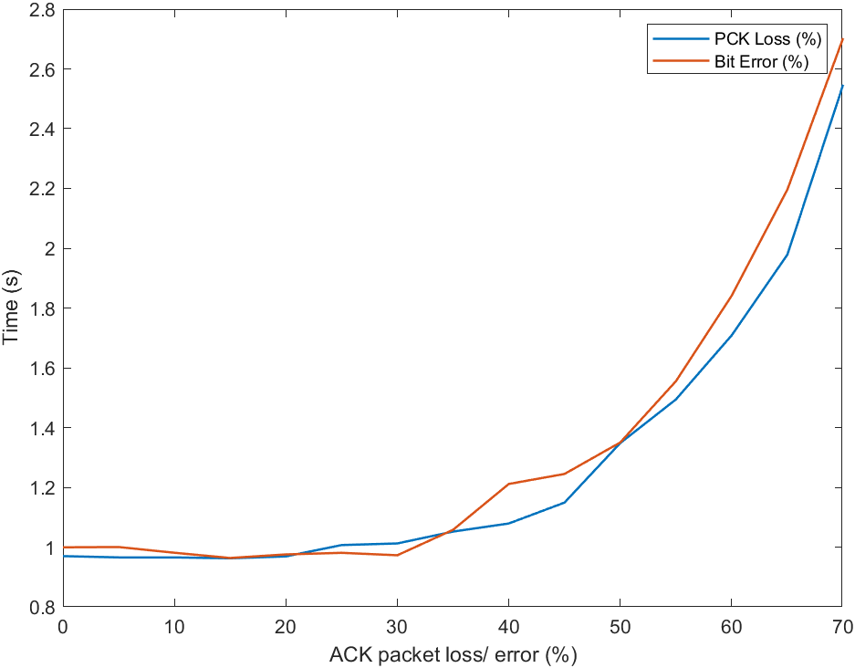
Chart 1: Phase 5 performance
The figure contains-
Average time plot for ACK packet loss and bit-error (%)

Slide 16
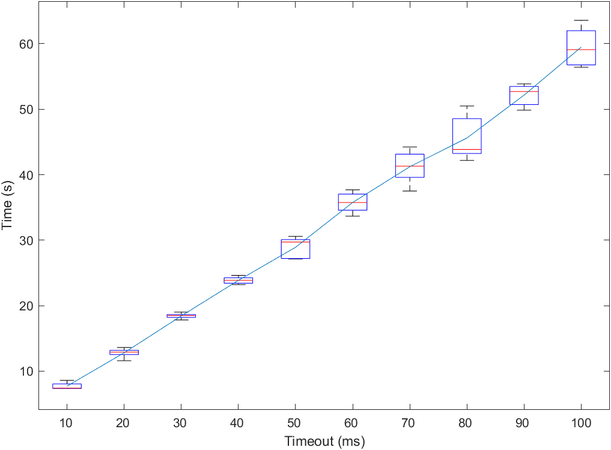
Chart 2: Optimal Timeout Value (20% Data Loss)

Slide 17
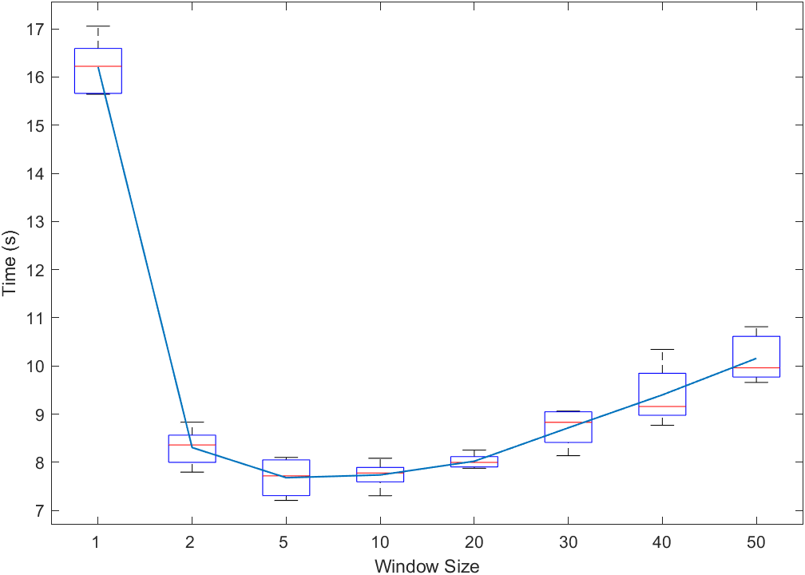
Chart 3: Optimal Window Size (20% Data Loss)

Slide 18
Chart-4
As different phases are run by separate team members at their computers, the file transfer time is inconsistent among the phases.

